Slide 1
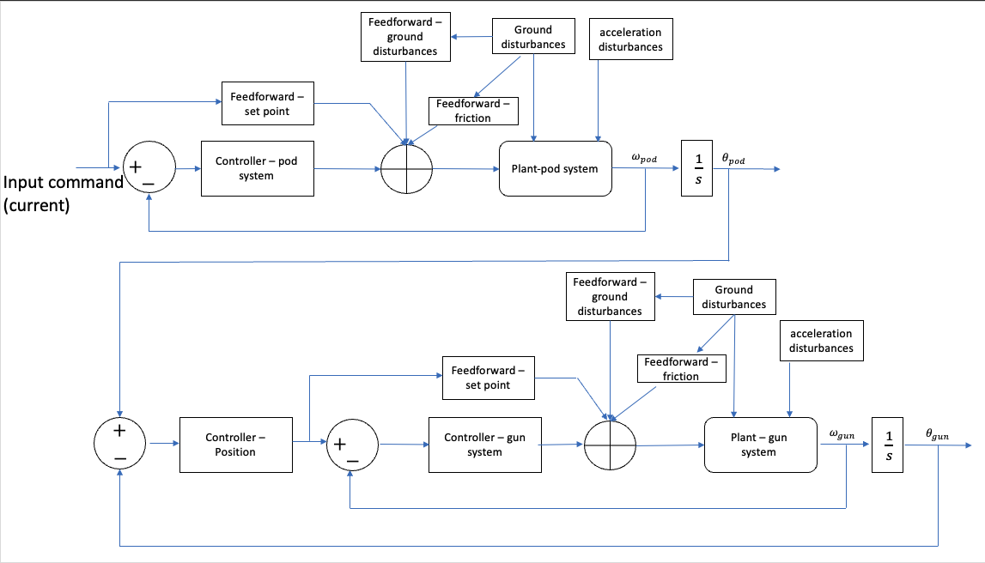



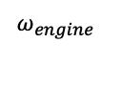









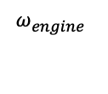


Feedforward – ground disturbances
ground disturbances
Acceleration disturbances
Feedforward – set point
Feedforward – friction
Plant – pod system
Input command(current[A])
Controllers – pod system
$$ω_{pod}$$
$$\frac{1}{s}$$
$$θ_{pod}$$
$$+$$
$$−$$
gyroscope
+ nonlinear
tachometer
$$ω_{engine}$$
Feedforward – ground disturbances
ground disturbances
Acceleration disturbances
Feedforward – set point
Feedforward – friction
Plant – gun system
$$+$$
Input command(current[A])
Controllers – gun system
$$ω_{gun}$$
$$\frac{1}{s}$$
$$θ_{gun}$$
Controller – position
$$+$$
gyroscope
$$−$$
$$−$$
+ nonlinear
tachometer
$$ω_{engine}$$
$$ω_{engine}$$
gyroscope
tachometer
$$ω_{engine}$$
gyroscope

Slide 2

MATLAB
Control system package PID tuner package
Transfer functions measurements
SIMULINK model – Gun Elevation
SIMULINK
Position control
Elevation
MATLAB sisotool
SIMULINK
linear molecules models (Plants)
X6
SIMULINK
PC nonlinear models
X6
SIMULINK
Linear
control models
X6
$$K_{k}{, K}_{V}$$
Mechanical parameters design list
Theoretical models
molecule
SIMULINK model – Pod Elevation
Theoretical models
Position control
Disturbances measurements
SIMULINK model – Gun Traverse
Disturbances measurements
MATLAB
Control system package PID tuner package
SIMULINK
Position control
Traverse
MATLAB
Control system package PID tuner package
SIMULINK model – Pod Traverse
Theoretical models
control elements
Theoretical model
Non-linear effects
SIMULINK
Control panel

Slide 3
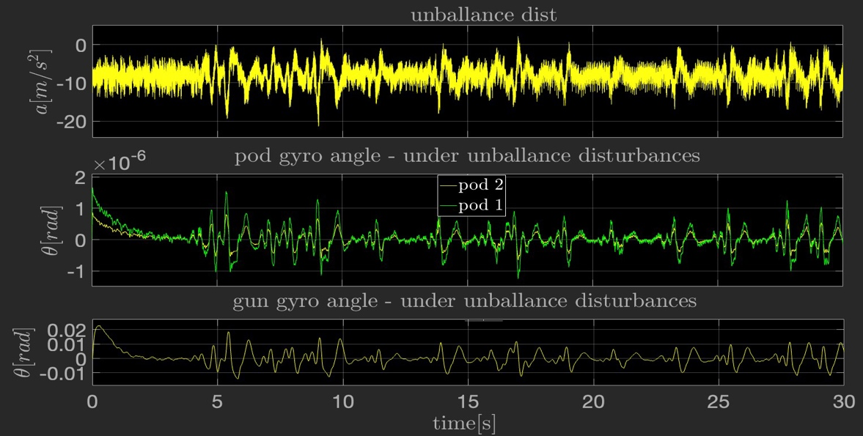




$$RMS=3.783e−04$$
$$RMS=2.763e−04$$
$$RMS=4.221e−04$$
$$RMS=4.907e−04$$

Slide 4
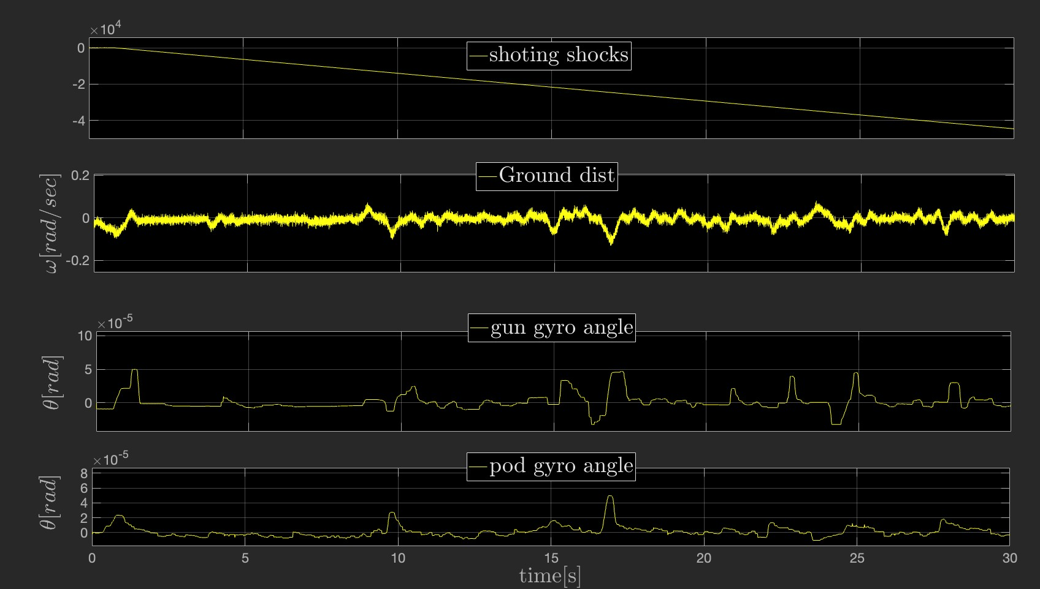
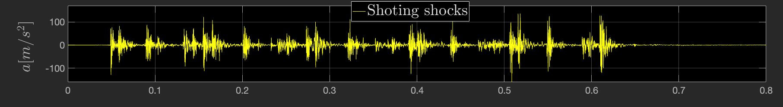
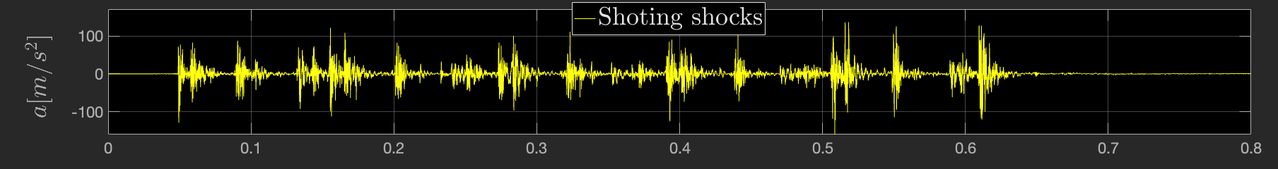

Slide 5
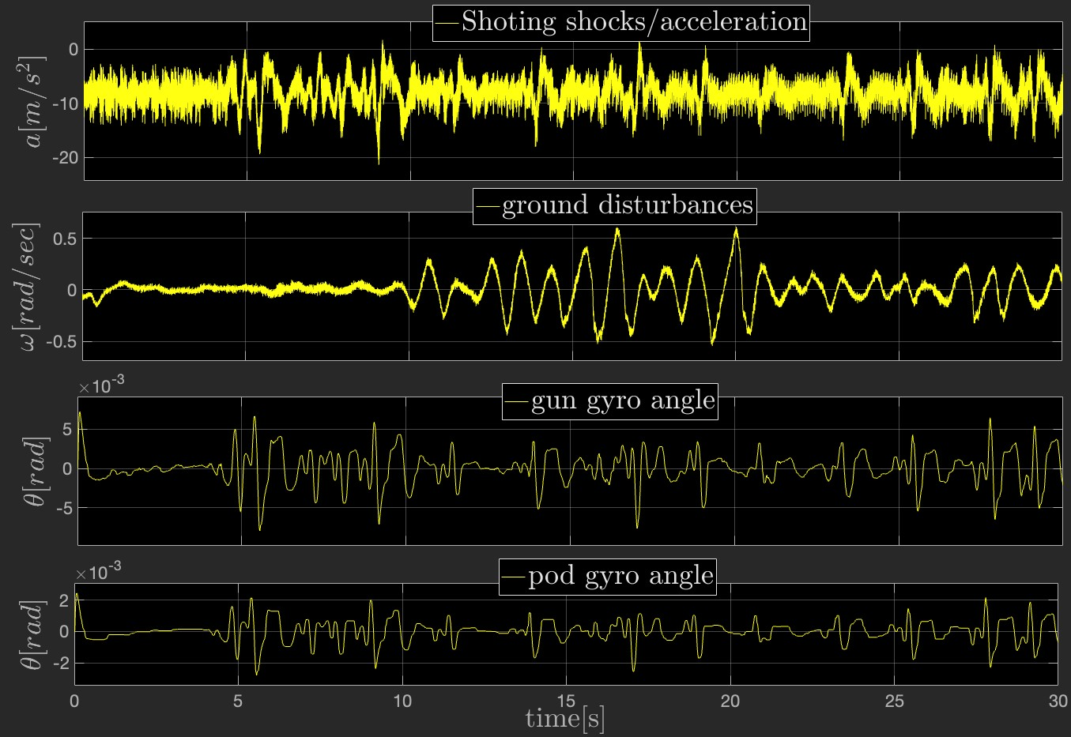



$$RMS=4.087e−04$$
$$RMS=4.987e−04$$

